Slide 1
Lecture 5:
Regularization
Pooya Mohammadi Lecture 5 - 1 Winter-2020

Slide 2
Last time: Neural Networks
$$x_{1}$$
Neural Network:
$$x_{2}$$
$$\hat{y}$$
$$x_{3}$$
a
a
Activation Functions:
z
z
ReLU
Leaky ReLU
Pooya Mohammadi Lecture 5 - 2 Winter-2020

Slide 3
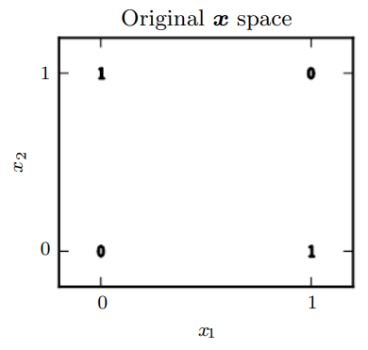
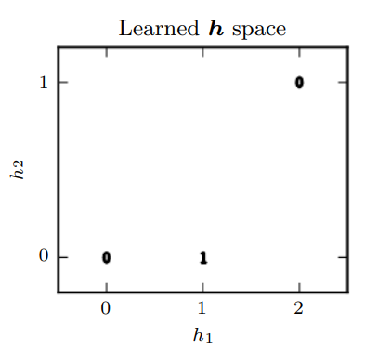
Last time: Representation Learning
$$x_{1}$$
$$h1$$
$$y$$
$$x_{2}$$
$$h2$$
Pooya Mohammadi Lecture 5 - 3 Winter-2020

Slide 4
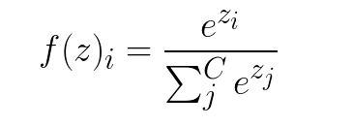
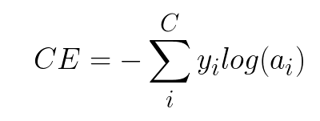
Last time: Multi-Classification
Soft-max
Cross-Entropy loss
Targets - Labels
One-Hot Encoding
Pooya Mohammadi Lecture 5 - 4 Winter-2020

Slide 5
Today
Regularization
Convolutional Neural Networks
Pooya Mohammadi Lecture 5 - 5 Winter-2020

Slide 6
Regularization
Most material from Andrew NG’s course at Coursera
Pooya Mohammadi Lecture 5 - 6 Winter-2020

Slide 7
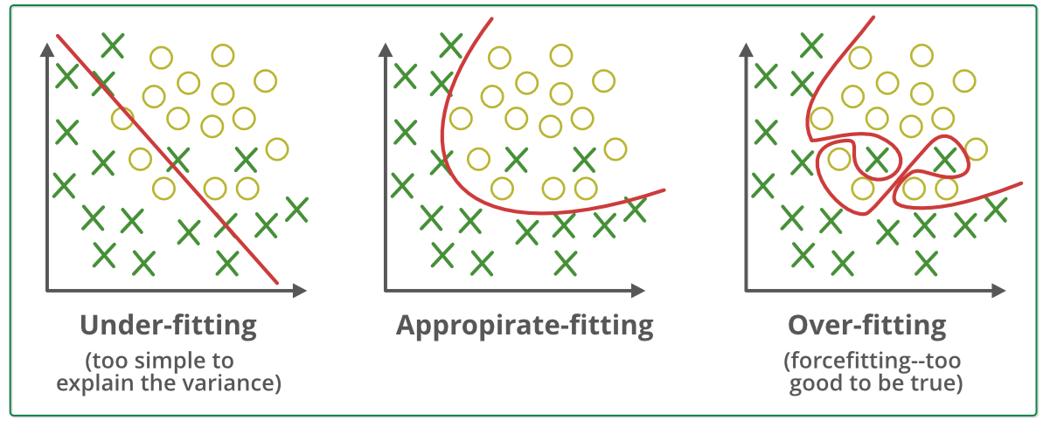
What is Over-fitting?
Pooya Mohammadi Lecture 5 - 7 Winter-2020

Slide 8
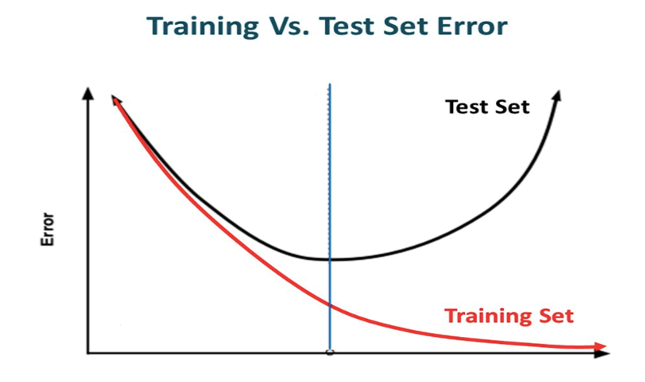
What is Over-fitting?
Pooya Mohammadi Lecture 5 - 8 Winter-2020

Slide 9


Regularization Techniques: L2
Loss:
Derivations:
Update:
Pooya Mohammadi Lecture 5 - 9 Winter-2020

Slide 10

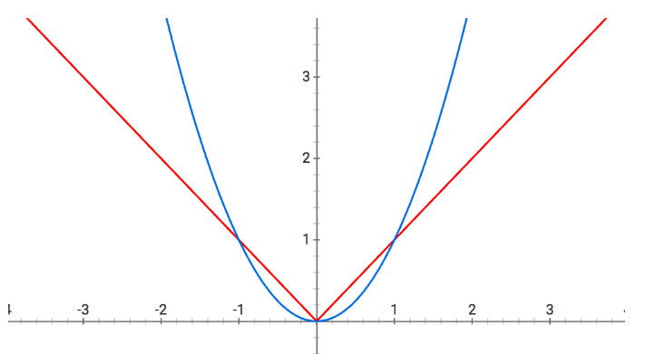
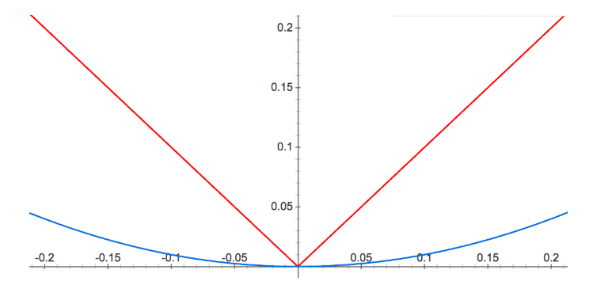
Regularization Techniques: L1
Loss:
Derivations:
Difference:
Pooya Mohammadi Lecture 5 - 10 Winter-2020

Slide 11
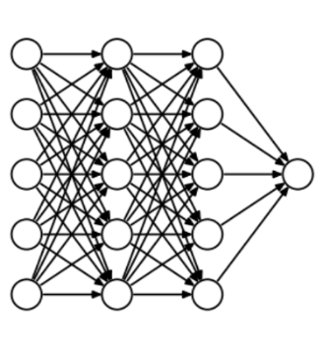
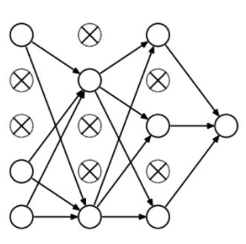
Regularization Techniques: Dropout
Without dropout
With dropout
Pooya Mohammadi Lecture 5 - 11 Winter-2020

Slide 12
Regularization Techniques: Dropout
Pooya Mohammadi Lecture 5 - 12 Winter-2020

Slide 13
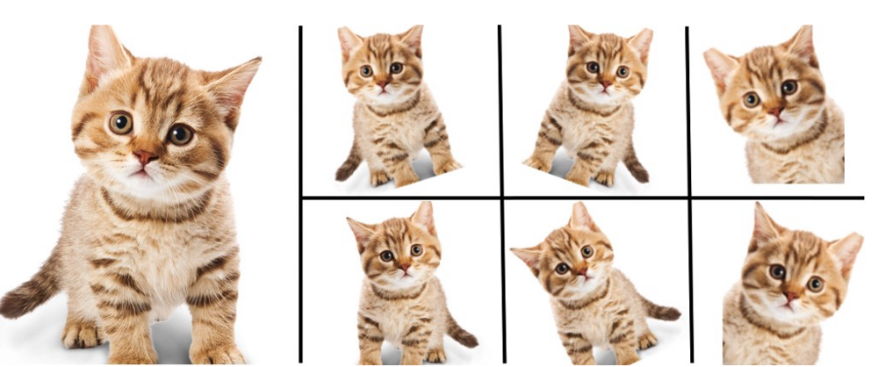
Regularization Techniques: Data Augmentation
Pooya Mohammadi Lecture 5 - 13 Winter-2020

Slide 14
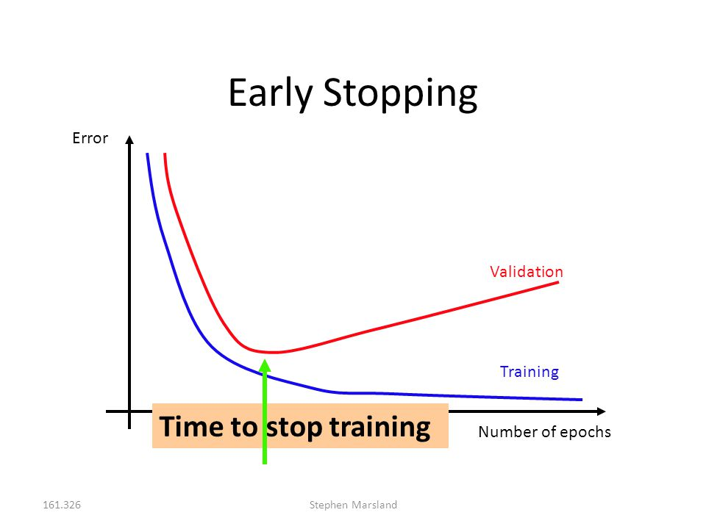
Regularization Techniques: Early Stopping
Pooya Mohammadi Lecture 5 - 14 Winter-2020

Slide 15
Questions??
Pooya Mohammadi Lecture 5 - 15 Winter-2020

